Slide 1
Data Visualization on bird-strike

Slide 2
introduction
In the realm of transport and communication, analytics play a pivotal role in addressing pressing environmental and safety challenges. Among these, bird strikes—collisions between birds and aircraft during various flight phases—pose a significant concern. These incidents can lead to considerable damage to aircraft structures and, especially for jet engines, may result in dangerous loss of thrust if birds are ingested. This risk is heightened during take-off, initial climb, approach, and landing, when aircraft are at lower altitudes with increased bird activity.
The Federal Aviation Administration (FAA) has collected extensive data on bird strikes from 2000 to 2011. By analyzing this data, we can gain insights into the frequency and impact of these collisions. Our goal is to understand these trends better and explore innovative solutions, including technological advancements and artificial intelligence, to mitigate the risks associated with bird strikes and enhance aviation safety.

Slide 3

Case studies
● Visuals Depicting the Number of Bird Strikes
● Yearly Analysis & Bird Strikes in the US
● Top 10 US Airlines in terms of having encountered bird strikes
● Airports with most incidents of bird strikes – Top 50
● Yearly Cost Incurred due to Bird Strikes:
● When do most bird strikes occur?
● Altitude of Aeroplanes at the time of strike
● Phase of flight at the time of the strike.
● Average Altitude of the Aeroplanes in different phases at the time of strike
● Effect of Bird Strikes & Impact on Flight
● Effect of Strike at Different Altitude
● Were Pilots Informed? & Prior Warning and Effect of Strike Relation

Slide 4
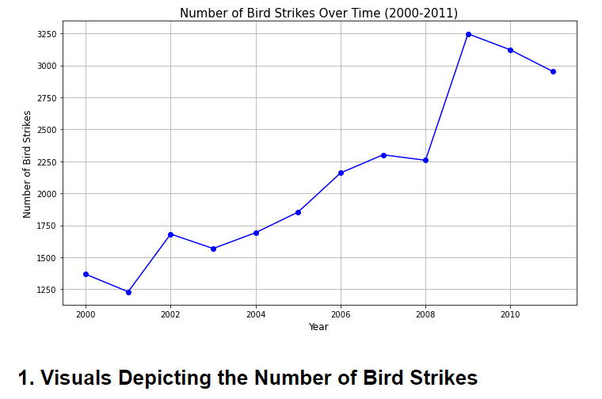
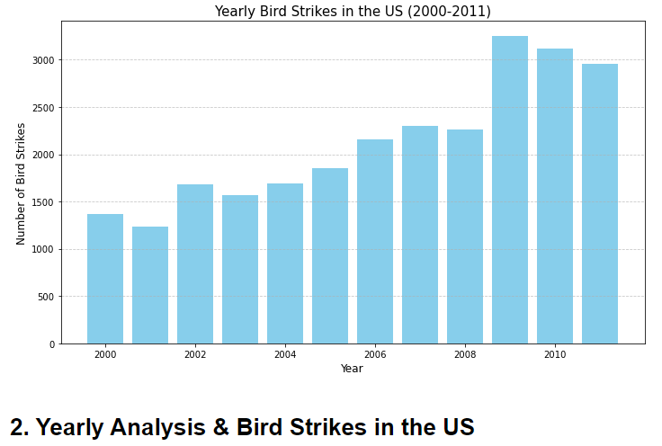
Data visualization

Slide 5
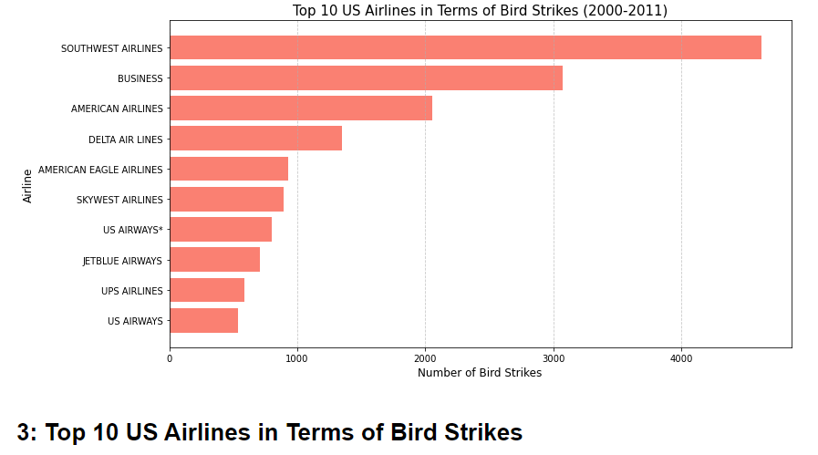
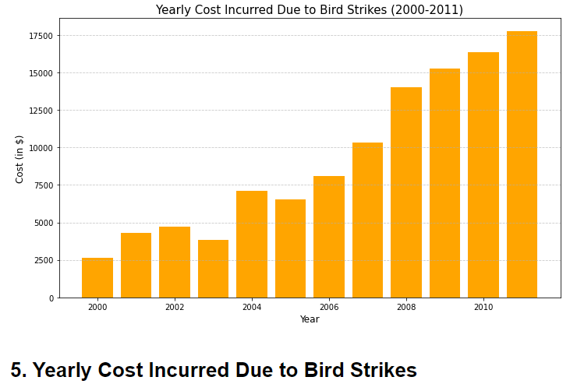
Data visualization

Slide 6
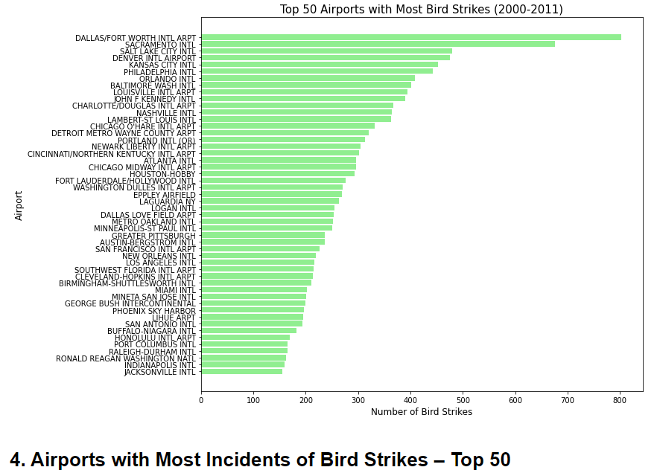
Data visualization

Slide 7
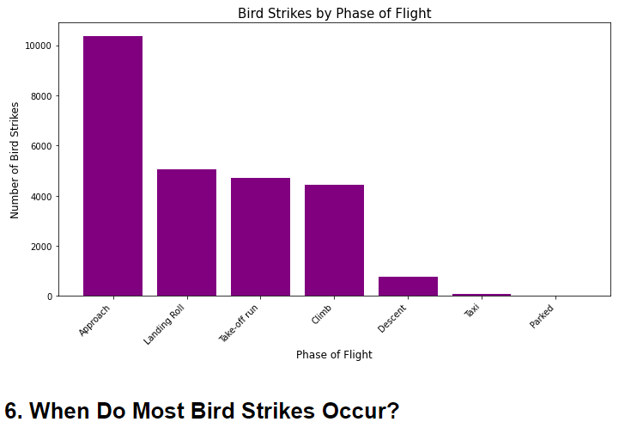
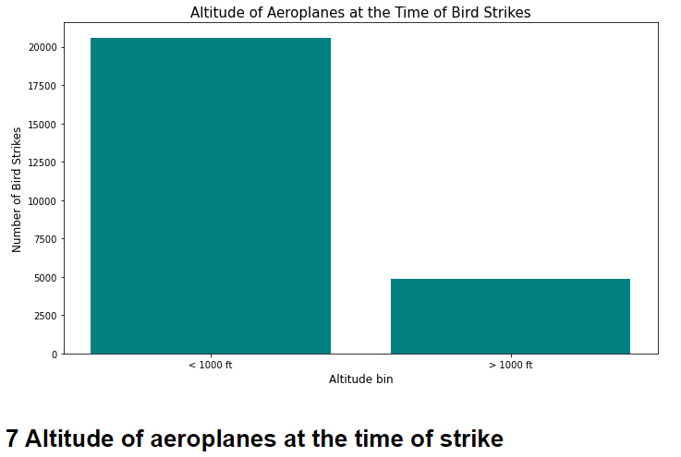
Data visualization

Slide 8
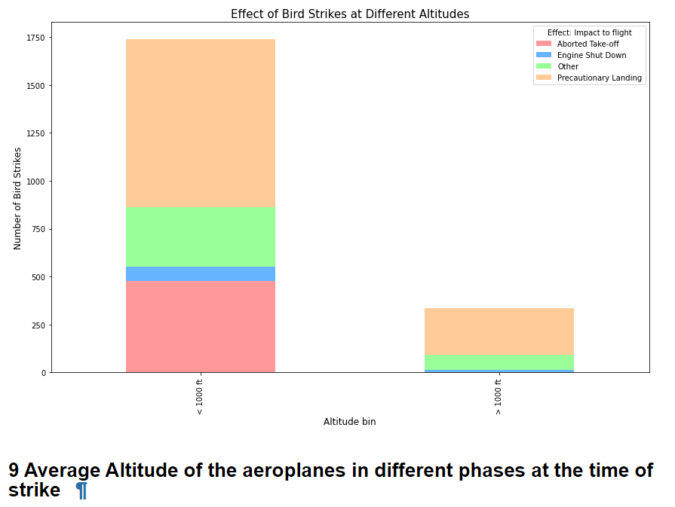
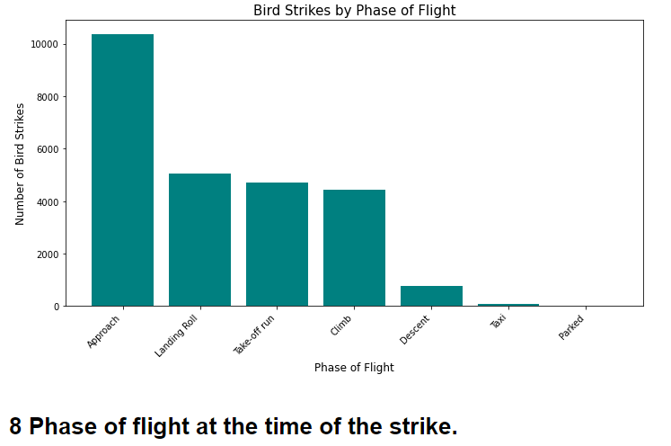
Data visualization

Slide 9
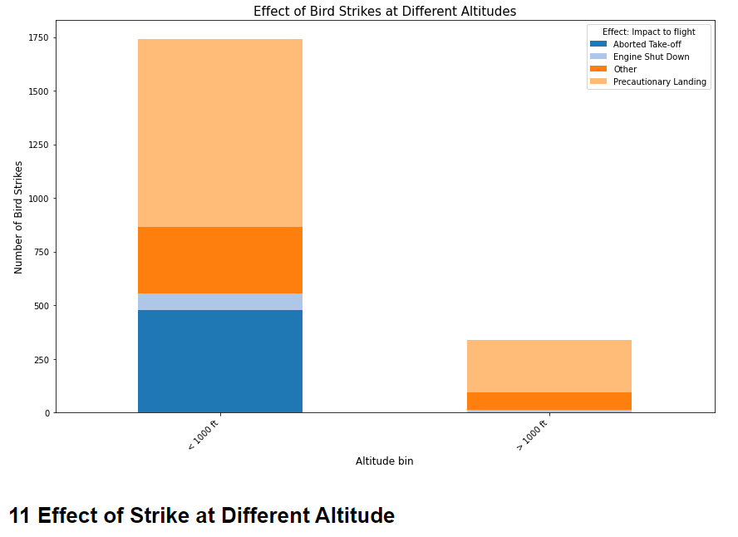
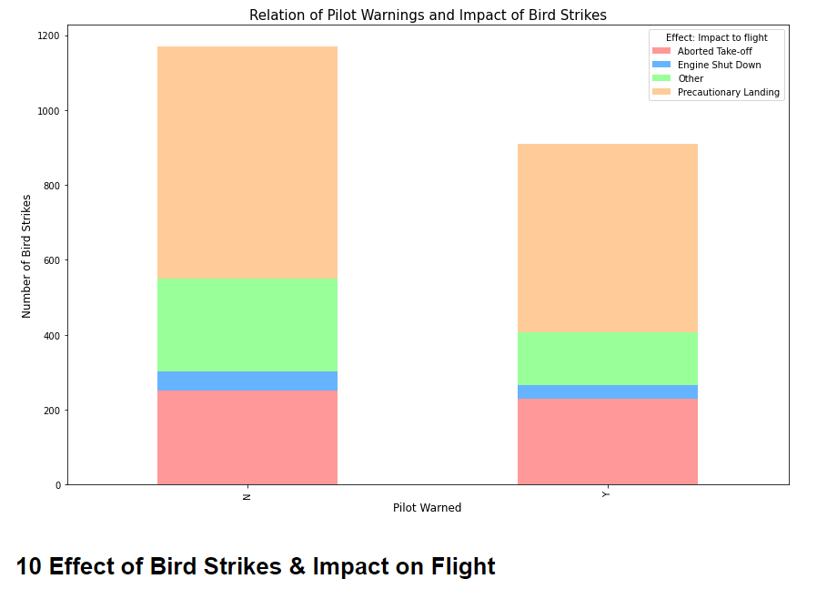
Data visualization

Slide 10
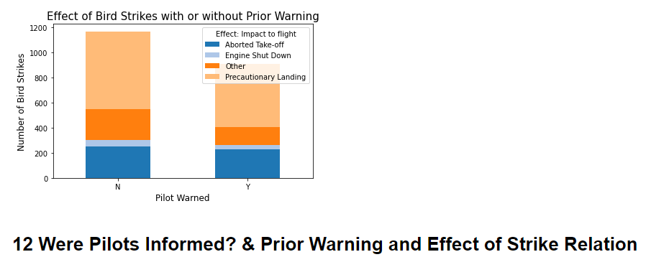
Data visualization

Slide 11
Thank you

